Slide 1
Detecting Potential Illegal or Harmful Activities in Online Communication

Slide 2
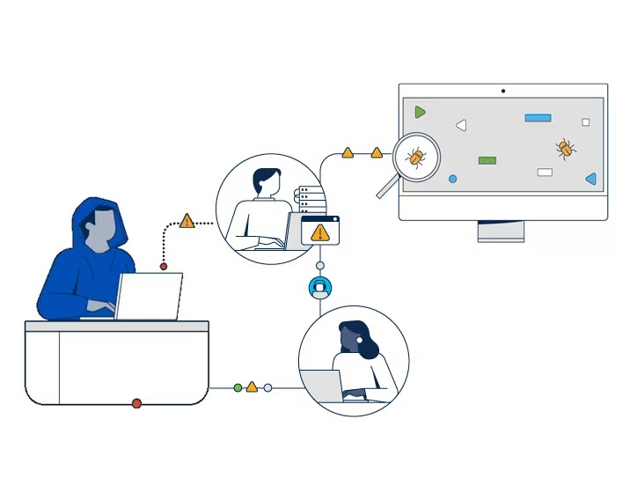
Background & Problem Definition:
Problem:
A prank message at Gatwick Airport triggered a costly €94,782 ($156,090) security response, showing how false alarms strain resources. Worse, millions of potential threats go undetected, exposing gaps in security monitoring systems.
Action:
The action involves developing a NLP model that analyzes and flags high-risk communications, such as harmful activities, by identifying suspicious patterns, harmful intent, and key entities in real-time. This model will strengthen monitoring systems and enable proactive intervention, ensuring that potential threats are detected early and effectively prevented.

Slide 3
Data Source and Preprocessing
Source: Jigsaw Toxic Comments dataset, data.gov, Controlled Language Models
Metadata:
Text Content
Labels (e.g., Cyberbullying, Extremism, Fraud, Conspiracy, Child Predation)
User Demographics
Interaction Metrics (Likes, Shares)
User Behavior Features
Time-related Features
Event Labels
Preprocessing:
Text normalization, tokenization, lemmatization, and removing irrelevant characters or phrases.
Downstream tasks like Word2Vec, GloVe.
SimHash or MinHash for identifying similar phases across conversations.

Slide 4
NLP Methodologies
.
Named Entity Recognition (NER): SpaCy’s pre-trained NER pipeline
Purpose: Identifies key entities like location, monetary values.
Sentiment Analysis: fine tuned models like RoBERTa or BERT
Purpose: Analyze emotional tone and intent behind messages.
Topic Analysis: LDA-based topic modeling
Purpose: Identify themes related to harmful or criminal activities.

Slide 5
Workflow Summary
Data Collection:
Preprocessing:
Analysis:
Integration:
Evaluation:

Slide 6
Model Evaluation
Qualitative Metrics:
Feedback:
False Positive Rate:
Quantitative Metrics:
Precision:
F1-Score:
Interpretability:

Slide 7
Requesting for Feedback ​
Thank You :)​

